Slide 1
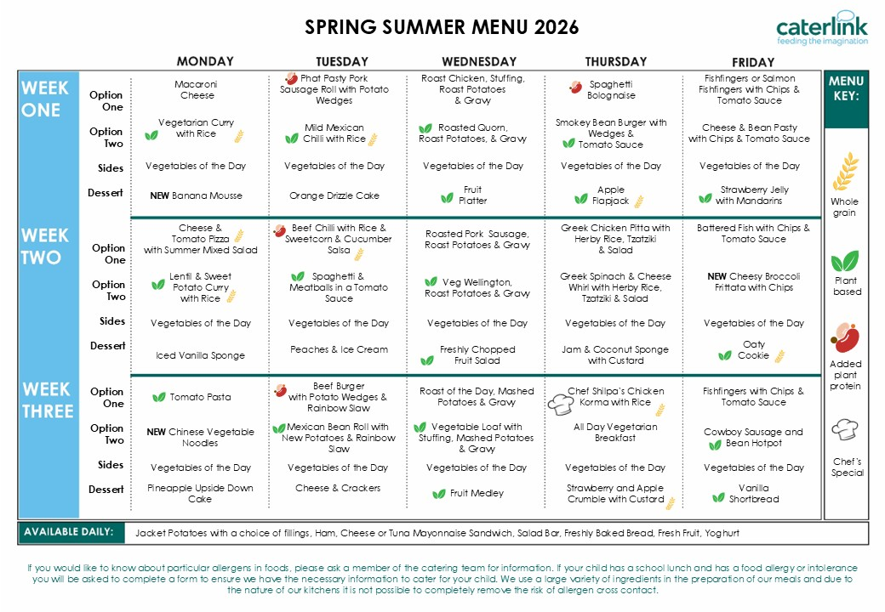
Enter Dates here
Enter Dates here
Enter Dates here

